Slide 1

Filmlane
“A Movie Recommendation System”
Project Members Supervisor
Ashok Basnet Pradip Khatiwada
Dipesh Rajbanshi
Konika Sitoula

Slide 2
Table of Contents
Introduction
Problem Statement
Objectives
Scope and Limitation
Development Methodology
Background Study and Literature Review
Related Works
System Analysis
Feasibility Analysis
Analysis
System Design
Algorithm Details
Implementation
Testing
Result Analysis
Conclusion
Future Recommendations
References
Appendices

Slide 3
Introduction
"Flimlane" is a web-based tool that helps in discovering movies and their descriptions. Its primary purpose is to assist users in finding a movie and suggesting similar ones based on their search.
It utilizes Content-based filtering which uses an algorithm that analyzes the features of movies such as genre, director, actors, and plot, and recommends similar movies to the user.

Slide 4
Problem Statement
There are endless options of online movies available which makes it challenging to locate a movie that matches with one's preferences. People invest their valuable time browsing on the internet to find a suitable movie that matches their interests. As movie preferences vary from person to person, it is necessary to read reviews and seek feedback from others before watching a film, which can be a troublesome process.

Slide 5
Objectives
To provide an online platform where movie lovers can find movies of their interests.
To apply Content-based Filtering technique for precise recommendations.

Slide 6
Scope and Limitation
Scope
It can be used to recommend movies based on the user's search content.
It makes searching of similar movies fast with the help of recommendation algorithm.
Limitation
It does not allow users to rate movies.
It is based on already saved dataset.
Content loading takes a long time.

Slide 7
Development Methodology
To build this system, we have used agile methodology which consists of different phases that are:
Requirement Gathering: At first, all the requirements related to the project are gathered.
Iteration: Iteration includes design, develop and test. In this phase, design of different components of the system is carried out. After designing elements, they are developed and tested.
Deploy: The final phase is deploy where the program is deployed on a server for everyone to access.

Slide 8
Background Study and Literature Review
Background Study
In the last decade, numerous recommendation systems have been created and are being utilized in various domains. These systems use diverse approaches like content-based, collaborative, knowledge-based, utility-based, and hybrid techniques. Online recommendation systems typically rely on previous user ratings to provide suggestions to current users who share similar interests. An example of such a system was developed by Jung, Harris, Webster, and Herlocker in 2004, which aimed to enhance search results.

Slide 9
Background Study and Literature Review
Literature review
The research paper investigates content-based filtering for generating movie recommendations using various techniques to convert text to vectors. The study combines multiple algorithms to create a final list of recommended movies. Data is pre-processed, and relevant features are consolidated into a single feature. Text from this feature is converted into vectors to determine similarity, and recommendations are generated based on these vectors. The final recommendations are slightly better than those generated by individual algorithms, indicating that combining different algorithms produces better results.[1]

Slide 10
Background Study and Literature Review
Literature review
The research aims to improve the CineMatch algorithm by incorporating modern collaborative filtering techniques to build a movie recommendation system. Different machine learning techniques are used to construct a Similarity matrix and Sparse matrix using movie ratings. Various algorithms are tested, including XGBoost, Matrix Factorization SVD, Surprise Baseline, and Surprise KNNBaseline Predictor, on the Netflix Prize dataset. The SVDpp algorithm is found to perform the best, achieving a Test RMSE of 1.0675.[2]

Slide 11
Related Works
IMDb
Rotten Tomatoes

Slide 12
System Analysis
Requirement Analysis
The process of requirement analysis involves communicating with system users to identify their specific feature expectations, resolving conflicts and documenting the project development process. The objective is to determine the requirements of the new system, starting with a survey of the existing system and investigating whether upgrading to an application program can address problems and inefficiencies. Two types of requirements are analysed while developing a system. They are:
Functional Requirements
Non-functional Requirements

Slide 13
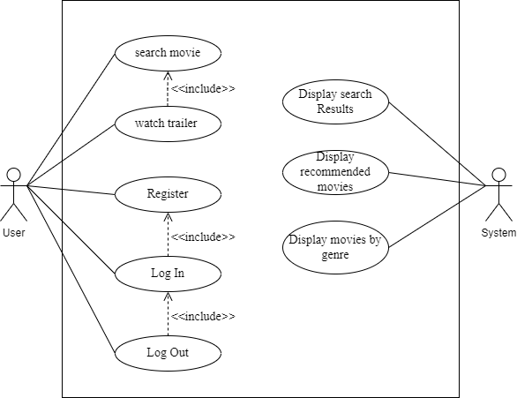
System Analysis
Fig: Use Case Diagram of the system

Slide 14
System Analysis
Functional Requirements | Non-functional Requirements
Recommend using Content-Based Filtering: Handle user movie requests: Watch Trailer: Search Movie: | Portability Maintainability Accessibility

Slide 15
Feasibility Analysis
There are three main types of feasibilities to be considered under this analysis. They are:
Technical Feasibility
Operational Feasibility
Schedule Feasibility

Slide 16
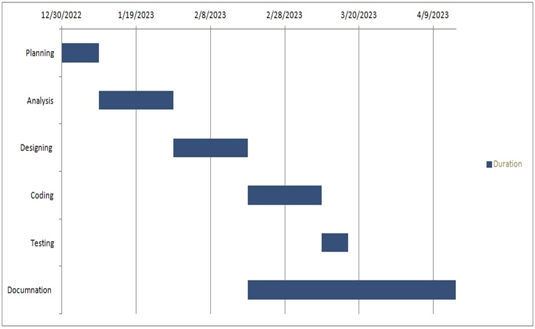
Feasibility Analysis
Fig : Gantt Chart for developing the system

Slide 17
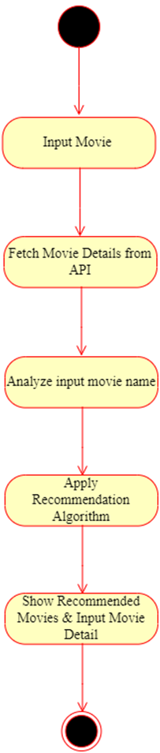
Analysis
State Diagram

Slide 18
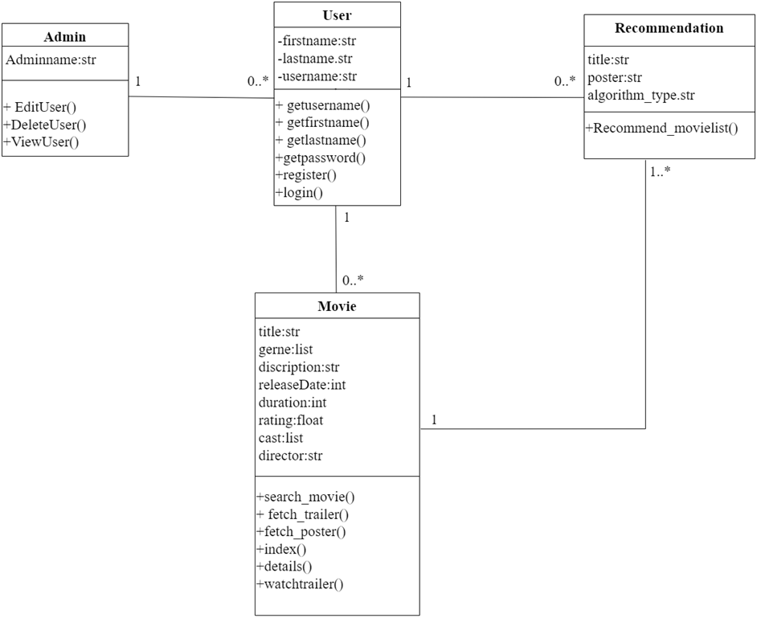
Analysis
class Diagram

Slide 19
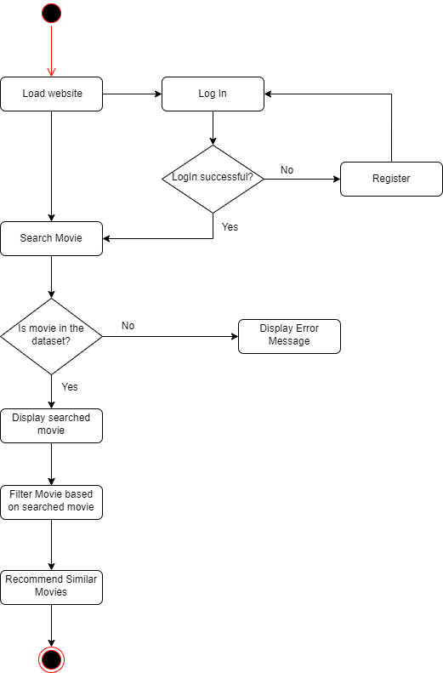
Analysis
Activity Diagram

Slide 20
System design
System Design
System design is an essential step in software development that requires significant effort and cost. To minimize errors and reduce costs, a prototyping model is often used to test software. The goal of system design is to plan and implement a practical solution to a problem, accomplished through two phases: logical design and physical design.

Slide 21
Algorithm Details
The project uses Content Based Filtering algorithm to recommend similar movies based on the search content of the user. Content-based filtering uses item gestures to recommend other items similar to what the user likes, based on their previous actions or explicit feedback.
Content-based filtering algorithm for movie recommendation system:
Step 1: Get user's watched history and movie preferences.
Step 2: Preprocess the movie data by extracting relevant features (such as genre, actors, director, year of release, etc.).
Step 3: Calculate the similarity score between each movie and the user's preferences based on the extracted features.
Step 4: Sort the movies in descending order of their similarity score with the user's preferences.
Step 5: Recommend the top N movies to the user.

Slide 22
Algorithm Details
Content-based filtering uses cosine similarity measure to recommend similar movies to the user. This algorithm calculates a similarity score between the attributes of the items in the system and the user's preferences. This score is computed using cosine similarity, which measures the similarity between two vectors. The algorithm compares the attributes of the items and the user's preferences by calculating the cosine similarity score between them. This score ranges from -1 to 1, where 1 means the items and user preferences are identical, 0 means they are completely different, and -1 means they are completely dissimilar. The algorithm then generates recommendations based on the top-ranked items that are most similar to the user's preferences.

Slide 23
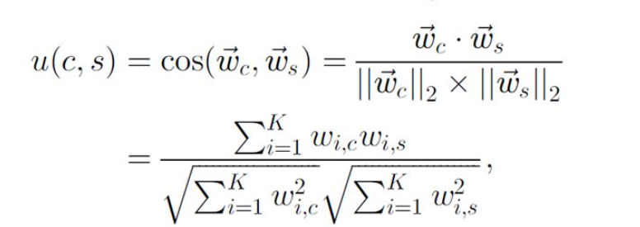
Algorithm Details
In information retrieval, a scoring heuristic is often used to represent the utility function u(c, s) based on vectors ⃗c and ⃗s, which can be measured using a cosine similarity measure. The number of keywords in the system is represented by K. By using cosine similarity or a similar measure, a recommender system can assign higher utility u(c, s) to articles with more heavily weighted bioinformatics terms in ⃗s and lower utility to articles with less heavily weighted bioinformatics terms.

Slide 24
Implementation
The tools and technologies used to implement this project are:
Tools Used
CASE tools: Visual Studio Code, draw.io, Git, GitHub
Programming Languages: HTML, CSS, Bootstrap, JavaScript, Python, Django
Database Platforms: SQLite, API

Slide 25
Implementation
Data collection
For this particular project, the data is not the primary focus, and it has been sourced from kaggle.com to train and test the system. The data has been extracted from two CSV dataset files, namely, tmdb_5000_credits.csv and tmdb_5000_movies.csv, which contain a total of 4806 data points. These files have been pre-processed and combined to form a final dataset file named "finaldataset.csv" that will be used for our recommendation system.

Slide 26
Implementation
Implementation of modules
Accounts: It consists of attributes: user name, first name, last name, e-mail and password. It consists of register method which allows a user to register a user and login method that allows a registered user to login to the system.
Search Data: It allows a user to input a movie name and search the movie details as well as recommends other similar movies to the user.
Movie class: It consists of attributes like movie title, released date, director, duration, cast, genre, rate, origin language, trailer, description. It consists of methods: index, search, details, fetch_poster, fetch_trailer and recommendation.
Index method
Search method
Details method
Recommendation method
Fetch_poster method
Fetch_trailer method

Slide 27
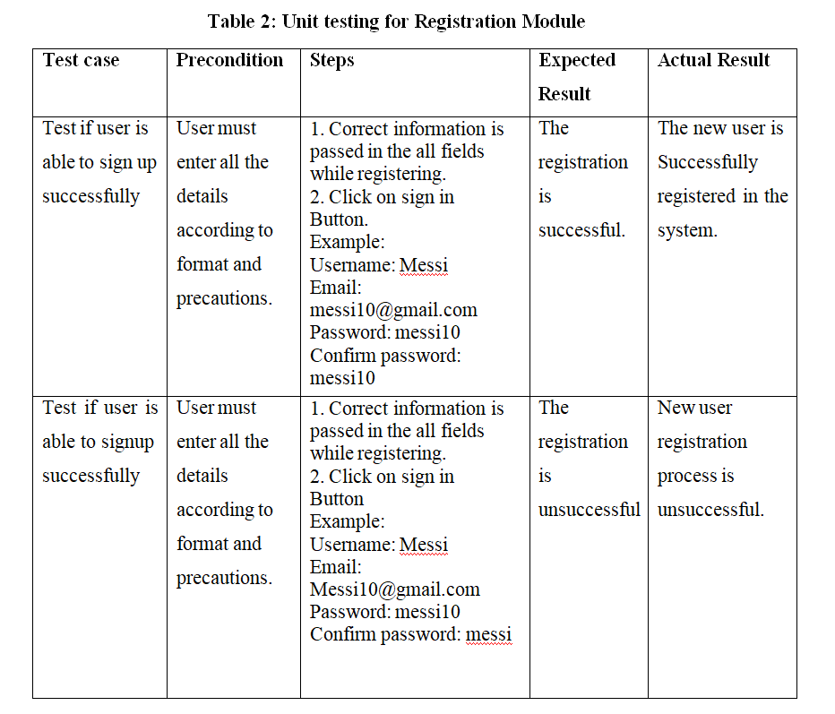
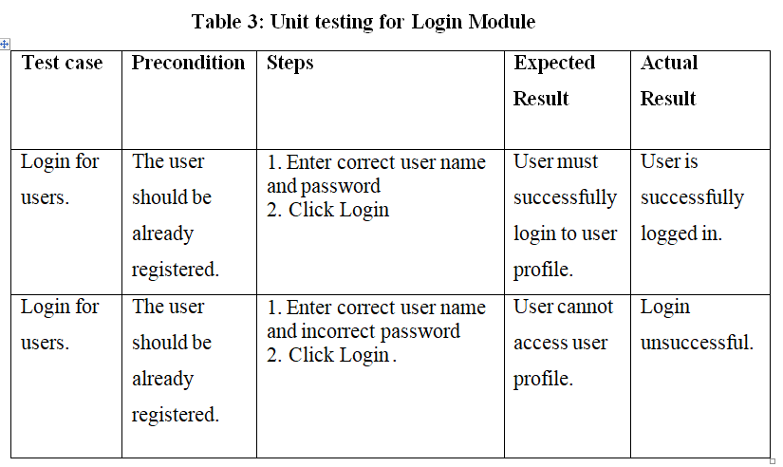
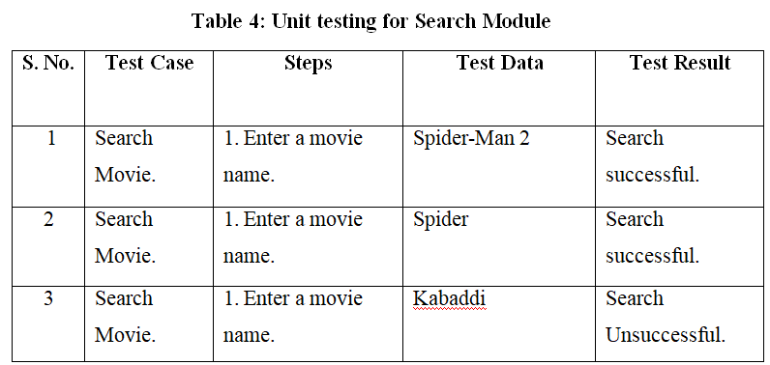
Testing

Slide 28
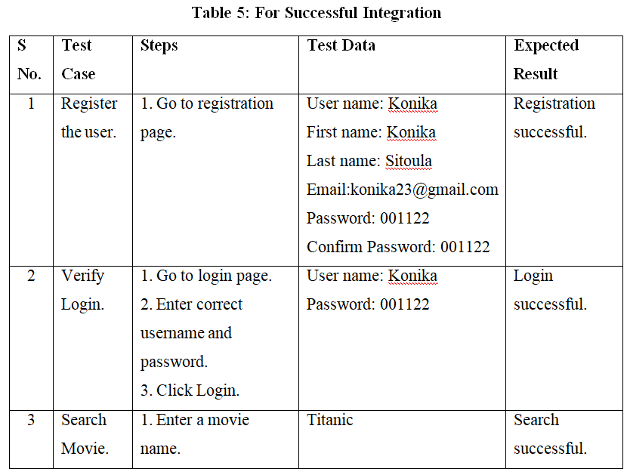
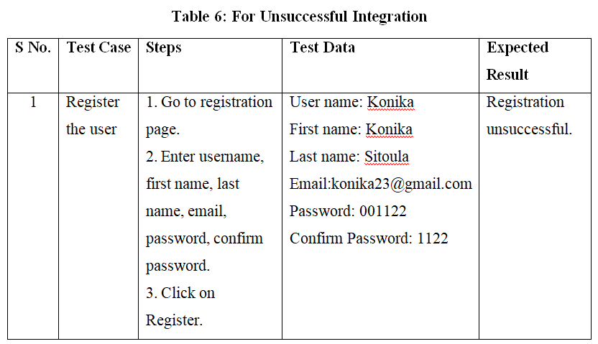
Testing

Slide 29
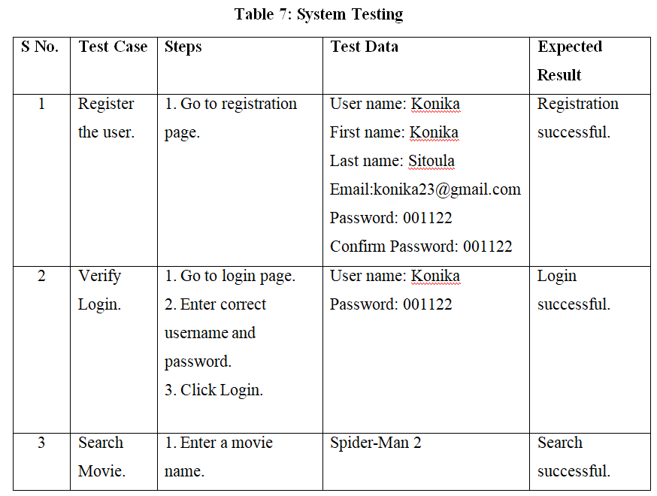
Testing

Slide 30
Result Analysis
After the movie name was given as an input by the user, the corresponding details of the input movie like title, genre, cast, released date, description, rating, etc. were shown and right below all those details the list of recommended movies using Content Based Filtering algorithm was shown. The main part of the project was to recommend other similar movies based on the search content of the user using the Content Based Filtering algorithm and the system successfully recommended the movies to the user.

Slide 31
Conclusion
With the implementation of this system the users will be able to get movies recommendations based on his or her interest and provide details about movie, cast, release date, ratings, descriptions, etc.

Slide 32
Future Recommendations
We can optimize this system by using different techniques to improve its performance and enhance user experience. This can be achieved by reducing the web-app load time, providing movie rating options, and enabling users to add movies to their wish list. By implementing these features and techniques, web applications can become faster, more efficient, and provide a better overall experience for users.

Slide 33
References
[1] M. B. Yeole, M. D. Rokade and S. S. Khatal, "Movie Recommendation System using Content based Filtering," vol. 7, no. 4 , pp. 633-648, 2021.
[2] M. C. Keshava, S. Srinivasulu, P. N. Reddy and B. D. Naik, "Machine Learning Model for Movie Recommendation System," International Journal of Engineering Research & Technology (IJERT), vol. 9, no. 4, pp. 800-805, 2020.
[3] N. Pradeep, R. K. Mangalore, B. Rajpal, N. Prasad and R. Shastri, "Content Based Movie Recommendation System," International Journal of Research in Industrial Engineering, vol. 9, no. 4, pp. 337-348, 2020.
[4] S. Sridhar, D. Dhanasekaran and P. C. Latha, "Content-Based Movie Recommendation System Using MBO with DBN," Intelligent Automation & Soft Computing, vol. 35, no. 3, pp. 3241-3257, 2022.
[5] O. Kunde, O. Gaikwad, P. Kelgandre, R. Damodhar and P. M. M. M. Swami, "The Movie Recommendation System using Content Based Filtering with TF-IDF Vectorization and Levenshtein Distance," International Journal of Advanced Research in Science, Communication and Technology (IJARSCT), vol. 2, no. 2, pp. 257-263, 2022.

Slide 34

Appendices
Fig: Home Page

Slide 35
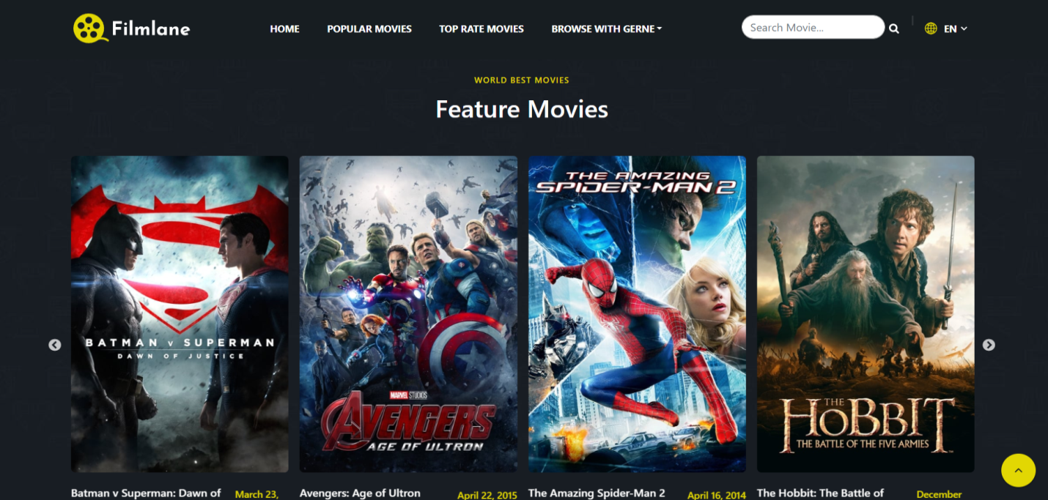
Appendices
Fig: Top Rated Movies

Slide 36
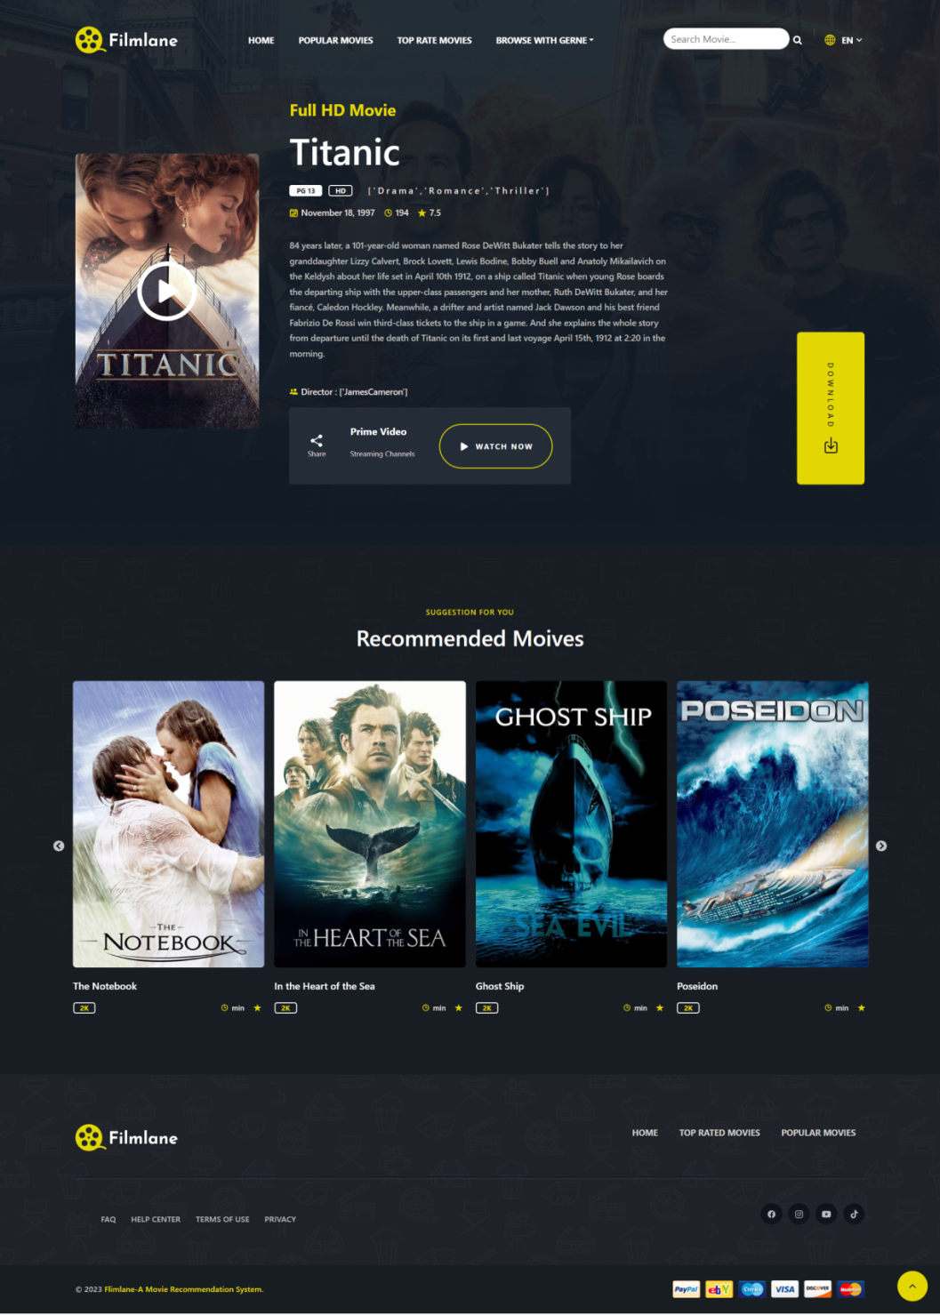
Appendices
Fig: Movie Details with Recommended Movies

Slide 37
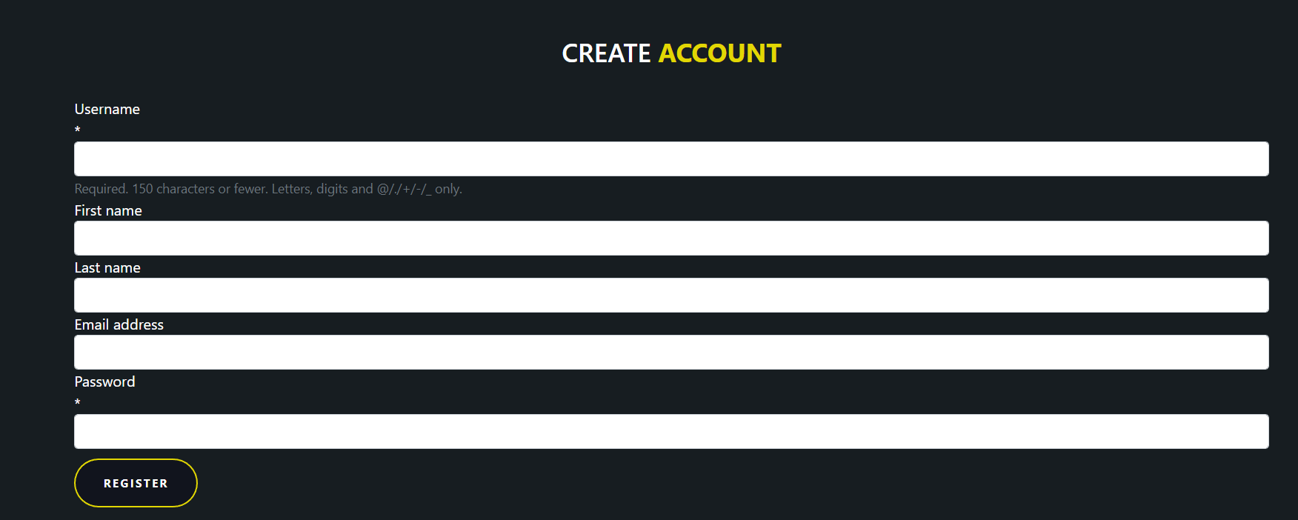
Appendices
Fig: Registration Page

Slide 38
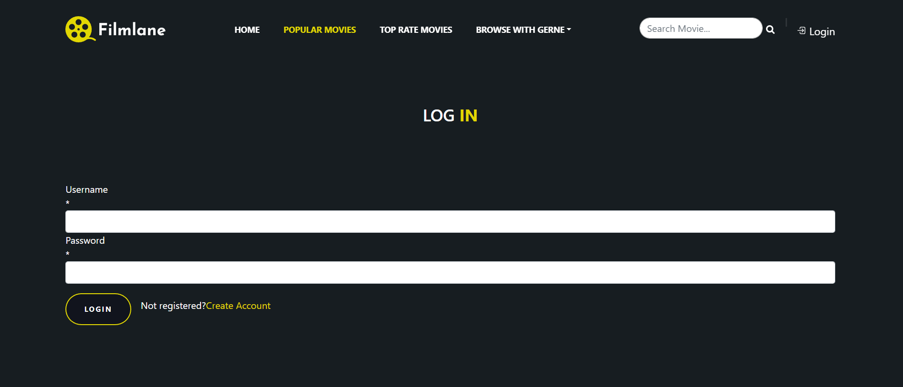
Appendices
Fig: LogIn Page

Slide 39
Thank You !

